Slide 1
5.1 Web Engineering
Web engineering focuses on the methodologies, techniques, and tools that are the foundation of Web application development and which support their design, development, evolution, and evaluation.
Web application development has certain characteristics that make it different from traditional software, information system, or computer application development.
Web engineering is multidisciplinary and encompasses contributions from diverse areas: systems analysis and design, software engineering, hypermedia/hypertext engineering, requirements engineering, human-computer interaction, user interface, data engineering, information science, information indexing and retrieval, testing, modelling and simulation, project management, and graphic design and presentation.
Web engineering is neither a clone nor a subset of software engineering, although both involve programming and software development. While Web Engineering uses software engineering principles, it encompasses new approaches, methodologies, tools, techniques, and guidelines to meet the unique requirements of Web-based applications

Slide 2
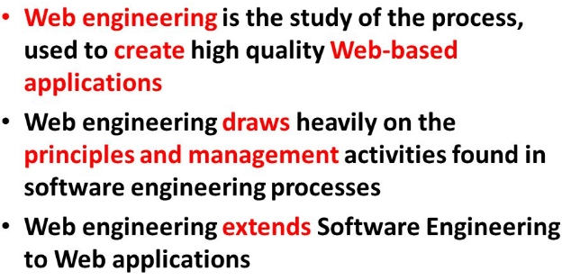
5.1 Web Engineering
Web Engineering

Slide 3
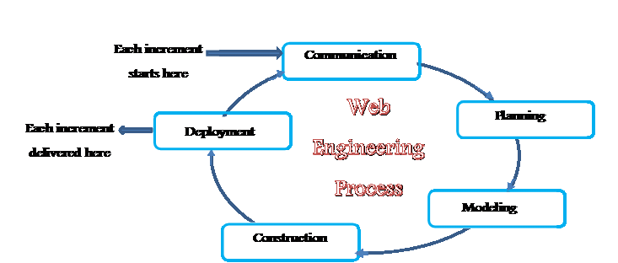
5.1 Web Engineering
Web Engineering

Slide 4
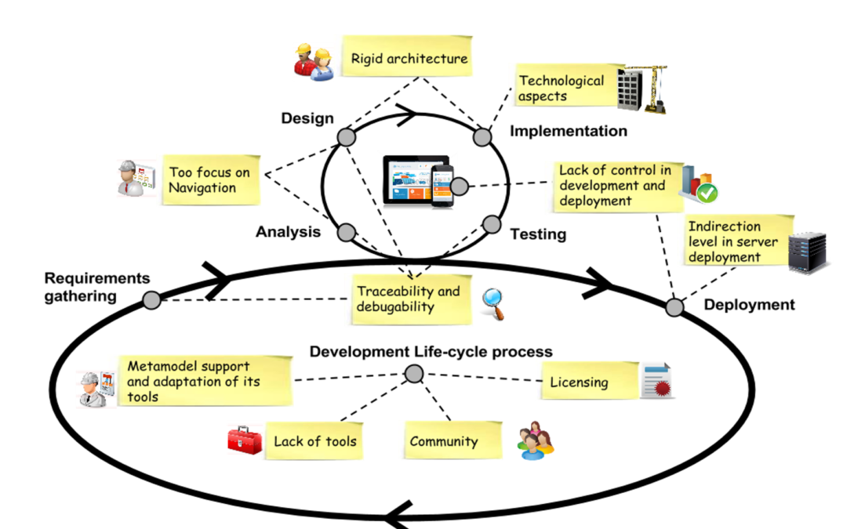
5.1 Web Engineering

Slide 5

5.1 Web Engineering

Slide 6
5.2 Agile Model
The meaning of Agile is swift or versatile. "Agile process model" refers to a software development approach based on iterative development. Agile methods break tasks into smaller iterations, or parts do not directly involve long term planning.
The project scope and requirements are laid down at the beginning of the development process. Plans regarding the number of iterations, the duration and the scope of each iteration are clearly defined in advance.
Each iteration is considered as a short time "frame" in the Agile process model, which typically lasts from one to four weeks. The division of the entire project into smaller parts helps to minimize the project risk and to reduce the overall project delivery time requirements.
Each iteration involves a team working through a full software development life cycle including planning, requirements analysis, design, coding, and testing before a working product is demonstrated to the client.

Slide 7
5.2 Agile Model
Phases of Agile Model:
Requirements gathering
Design the requirements
Construction/ iteration
Testing/ Quality assurance
Deployment
Feedback

Slide 8
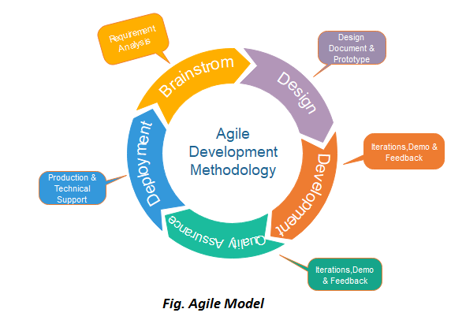
5.2 Agile Model

Slide 9
5.2 Agile Model
1. Requirements gathering: In this phase, you must define the requirements. You should explain business opportunities and plan the time and effort needed to build the project. Based on this information, you can evaluate technical and economic feasibility.
2. Design the requirements: When you have identified the project, work with stakeholders to define requirements. You can use the user flow diagram or the high-level UML diagram to show the work of new features and show how it will apply to your existing system.
3. Construction/ iteration: When the team defines the requirements, the work begins. Designers and developers start working on their project, which aims to deploy a working product. The product will undergo various stages of improvement, so it includes simple, minimal functionality.
4. Testing: In this phase, the Quality Assurance team examines the product's performance and looks for the bug.
5. Deployment: In this phase, the team issues a product for the user's work environment.
6. Feedback: After releasing the product, the last step is feedback. In this, the team receives feedback about the product and works through the feedback.

Slide 10
5.2 Agile Model
Advantage(Pros) of Agile Method:
Frequent Delivery
Face-to-Face Communication with clients.
Efficient design and fulfils the business requirement.
Anytime changes are acceptable.
It reduces total development time.

Slide 11
5.2 Agile Model
Disadvantage(Cons) of Agile Method:
Due to the shortage of formal documents, it creates confusion and crucial decisions taken throughout various phases can be misinterpreted at any time by different team members.
Due to the lack of proper documentation, once the project completes and the developers allotted to another project, maintenance of the finished project can become a difficulty.

Slide 12
5.2 Agile Methods:
Scrum
Crystal
Dynamic Software Development Method(DSDM)
Feature Driven Development(FDD)
eXtreme Programming(XP)

Slide 13
5.2.1: Extreme Programming(XP)
What Is Extreme Programming (XP)?
Extreme programming is a software development methodology that’s part of what’s collectively known as agile methodologies. XP is built upon values, principles, and practices, and its goal is to allow small to mid-sized teams to produce high-quality software and adapt to evolving and changing requirements.
Extreme programming (XP) is one of the most important software development frameworks of Agile models. It is used to improve software quality and responsiveness to customer requirements. The extreme programming model recommends taking the best practices that have worked well in the past in program development projects to extreme levels.

Slide 14
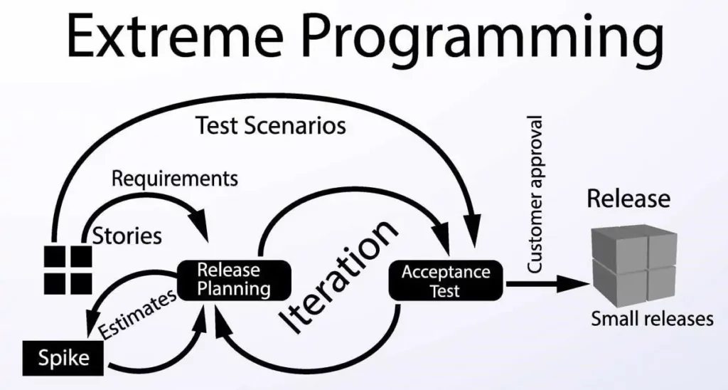
5.2.1: Extreme Programming(XP)

Slide 15
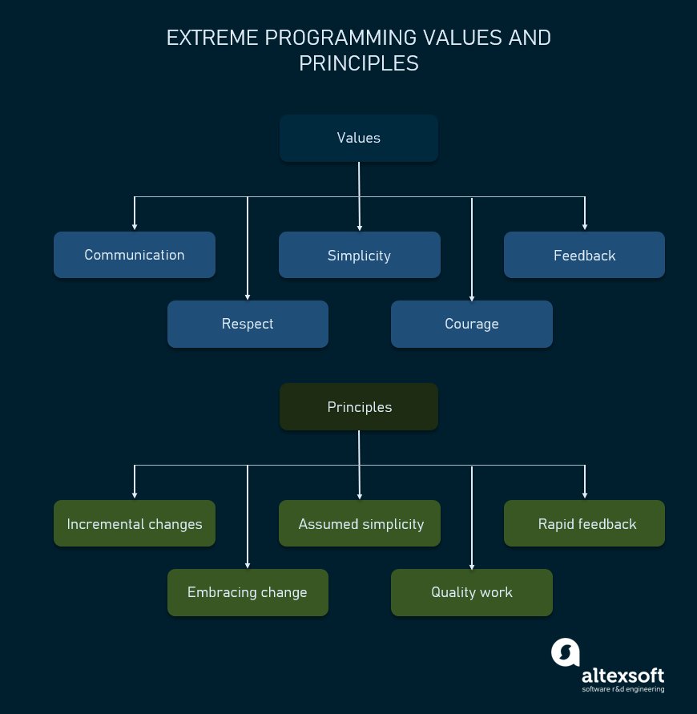
5.2.1: Extreme Programming(XP)
XP Values:

Slide 16
5.2.1: Extreme Programming(XP)
XP Values:
Communication: Lack of communication prevents knowledge from flowing inside a team. Often, when there’s a problem, someone already knows how to solve it. But lack of communication prevents them from learning about the problem or contributing to its solution. So, the problem ends up being solved twice, generating waste.
Simplicity: Simplicity says you always strive to do the simplest thing that works. It’s often misunderstood and taken as the simplest thing, period, ignoring the “that works” part.It’s also crucial to remember that simplicity is highly contextual. What’s simple for one team, is complex for another depending entirely on each team’s skills, experience, and knowledge.
Feedback: Feedback in more traditional, waterfall-like software development methodologies often is
Courage: Kent Beck defines courage as “effective action in the face of fear.” As a software engineer, you have plenty to be afraid of and therefore plenty of opportunities to show courage.It takes courage to speak the truth, especially unpleasant ones — for instance, honest estimates. Giving and receiving feedback also takes courage. And it takes courage to avoid falling into the sunk cost fallacy and discard a failing solution that received substantial investments.
Respect: A fundamental premise of XP is that everyone cares about their work. No amount of technical excellence can save a project if there’s no care and respect.

Slide 17
5.2.1: Extreme Programming(XP)
Applications of Extreme Programming (XP): Some of the projects that are suitable to develop using the XP model are given below:
Small projects: XP model is very useful in small projects consisting of small teams as face-to-face meeting is easier to achieve.
Projects involving new technology or Research projects: This type of project face changing requirements rapidly and technical problems. So XP model is used to complete this type of project.
Web development projects: XP model is well-suited for web development projects as the development process is iterative and requires frequent testing to ensure the system meets the requirements.
Collaborative projects: XP model is useful for collaborative projects that require close collaboration between the development team and the customer.
Projects with tight deadlines: XP model can be used in projects that have a tight deadline, as it emphasizes simplicity and iterative development.
Projects with rapidly changing requirements: XP model is designed to handle rapidly changing requirements, making it suitable for projects where requirements may change frequently.
Projects where quality is a high priority: XP model places a strong emphasis on testing and quality assurance, making it a suitable approach for projects where quality is a high priority.

Slide 18
5.2.1: Extreme Programming(XP)
Advantages of Extreme Programming (XP):
Slipped schedules − Timely delivery is ensured through slipping timetables and doable development cycles.
Misunderstanding the business and/or domain − Constant contact and explanations are ensured by including the client on the team.
Canceled projects − Focusing on ongoing customer engagement guarantees open communication with the consumer and prompt problem-solving.
Staff turnover − Teamwork that is focused on cooperation provides excitement and goodwill. Team spirit is fostered by multidisciplinary cohesion.
Costs incurred in changes − Extensive and continuing testing ensures that the modifications do not impair the functioning of the system. A functioning system always guarantees that there is enough time to accommodate changes without impairing ongoing operations.
Business changes − Changes are accepted at any moment since they are seen to be inevitable.
Production and post-delivery defects: Emphasis is on − the unit tests to find and repair bugs as soon as possible.

Slide 19
5.2.2 Dynamic Systems Development Method(DSDM)
The Dynamic Systems Development technique (DSDM) is an associate degree agile code development approach that provides a framework for building and maintaining systems. The DSDM philosophy is borrowed from a modified version of the sociologist principle—80 % of An application is often delivered in twenty percent of the time it’d desire deliver the entire (100 percent) application.
DSDM is An iterative code method within which every iteration follows the 80% rule that simply enough work is needed for every increment to facilitate movement to the following increment. The remaining detail is often completed later once a lot of business necessities are noted or changes are requested and accommodated.
The DSDM tool (www.dsdm.org) could be a worldwide cluster of member companies that put together tackle the role of “keeper” of the strategy. The pool has outlined AN Agile Development Model, known as the DSDM life cycle that defines 3 different unvarying cycles, preceded by 2 further life cycle activities:

Slide 20
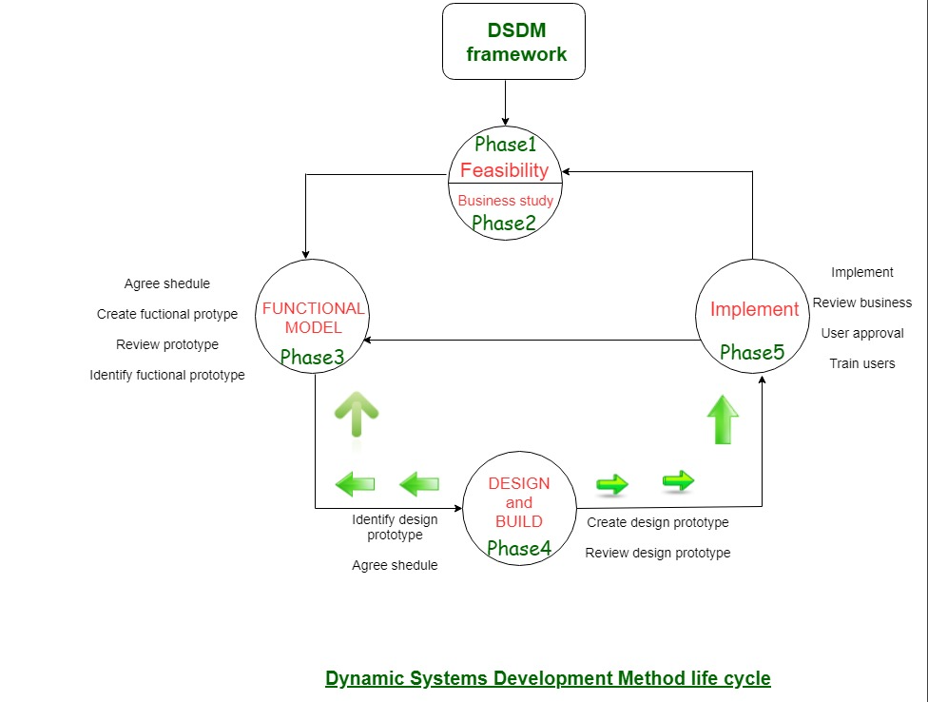
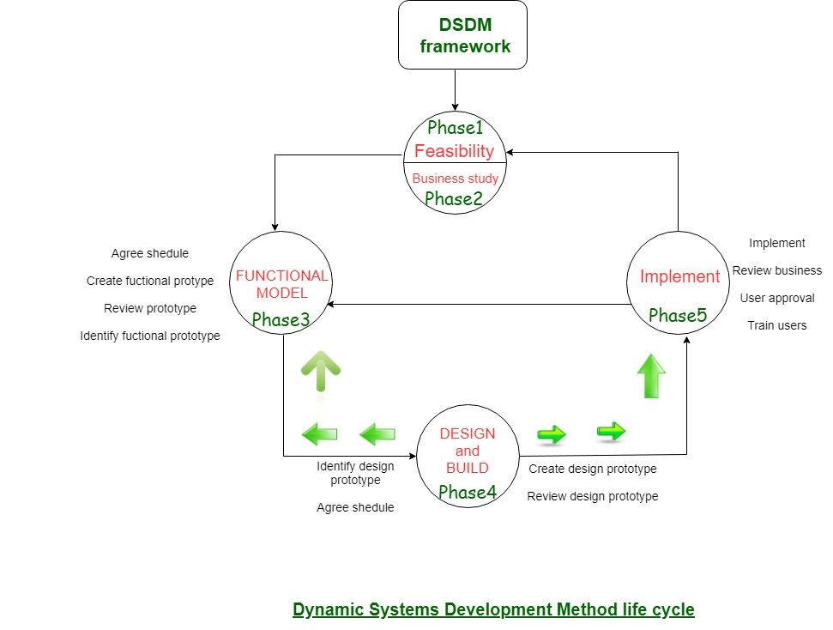
5.2.2 Dynamic Systems Development Method(DSDM)

Slide 21
5.2.2 Dynamic Systems Development Method(DSDM)
Feasibility Study: It establishes the essential business necessities and constraints related to the applying to be designed then assesses whether or not the application could be a viable candidate for the DSDM method.
Business Study: It establishes the use and knowledge necessities that may permit the applying to supply business value; additionally, it is the essential application design and identifies the maintainability necessities for the applying.
Functional Model Iteration: It produces a collection of progressive prototypes that demonstrate practicality for the client. (Note: All DSDM prototypes are supposed to evolve into the deliverable application.) The intent throughout this unvarying cycle is to collect further necessities by eliciting feedback from users as they exercise the paradigm.
Design and Build Iteration: It revisits prototypes designed throughout useful model iteration to make sure that everyone has been designed during a manner that may alter it to supply operational business price for finish users. In some cases, useful model iteration and style and build iteration occur at the same time.
Implementation: It places the newest code increment (an “operationalized” prototype) into the operational surroundings. It ought to be noted that:
(a) the increment might not 100% complete or,
(b) changes are also requested because the increment is placed into place. In either case, DSDM development work continues by returning to the useful model iteration activity.

Slide 22

5.2.3 Feature Driven Development

Slide 23
5.2.3 Feature Driven Development
Feature-Driven Development. It is an agile iterative and incremental model that focuses on progressing the features of the developing software. The main motive of feature-driven development is to provide timely updated and working software to the client. In FDD, reporting and progress tracking is necessary at all levels.
History
FDD was first applied in the year 1997 on a real-world application by Jeff De Luca for large software development with specific needs of 15-month and 50 persons and published as a discussion in book Java Modeling in Color with UML in the year 1999.
FDD Lifecycle
Build overall model
Build feature list
Plan by feature
Design by feature
Build by feature

Slide 24
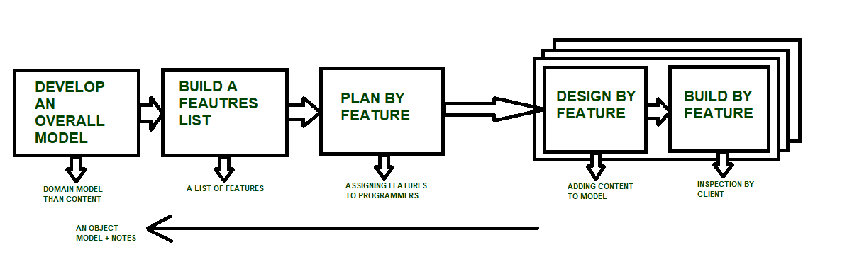
5.2.3 Feature Driven Development
Build by feature

Slide 25
5.2.3 Feature Driven Development
Characteristics of FDD
Short iterative: FDD lifecycle works in simple and short iterations to efficiently finish the work on time and gives good pace for large projects.
Customer focused: This agile practice is totally based on inspection of each feature by client and then pushed to main build code.
Structured and feature focused: Initial activities in lifecycle builds the domain model and features list in the beginning of timeline and more than 70% of efforts are given to last 2 activities.
Frequent releases: Feature-driven development provides continuous releases of features in the software and retaining continuous success of the project.

Slide 26
5.2.3 Feature Driven Development
Advantages of FDD
Reporting at all levels leads to easier progress tracking.
FDD provides continuous success for larger size of teams and projects.
Reduction in risks is observed as whole model and design is build in smaller segments.
FDD provides greater accuracy in cost estimation of the project due to feature segmentation retaining continuous success of the project.

Slide 27
5.2.3 Feature Driven Development
Disadvantages of FDD
This agile practice is not good for smaller projects.
There is high dependency on lead programmers, designers and mentors.
There is lack of documentation which can create an issue afterwards.

Slide 28
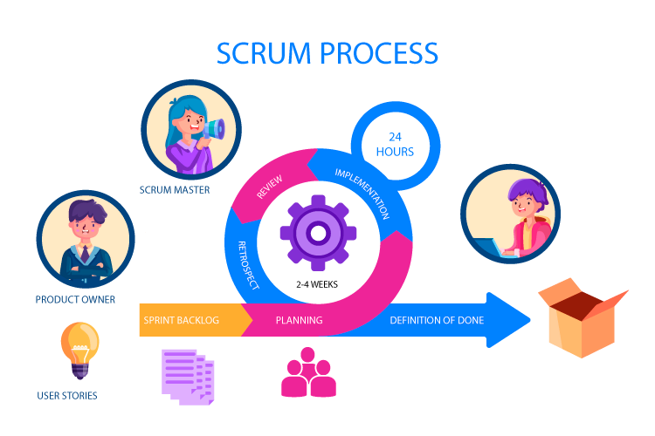
5.2.4 SCRUM

Slide 29
5.2.4 SCRUM
Scrum is precisely an evolution of Agile Management. Scrum methodology is based on a set of very defined practices and roles that must be involved during the software development process. It is a flexible methodology that rewards the application of the 12 agile principles in a context agreed by all the team members of the product.
Scrum is executed in temporary blocks that are short and periodic, called Sprints, which usually range from 2 to 4 weeks, which is the term for feedback and reflection. Each Sprint is an entity in itself, that is, it provides a complete result, a variation of the final product that must be able to be delivered to the client with the least possible effort when requested.
The process has as a starting point, a list of objectives/ requirements that make up the project plan. It is the client of the project that prioritizes these objectives considering a balance of the value and the cost thereof, that is how the iterations and consequent deliveries are determined.
On the one hand the market demands quality, fast delivery at lower costs, for which a company must be very agile and flexible in the development of products, to achieve short development cycles that can meet the demand of customers without undermining the quality of the result. It is a very easy methodology to implement and very popular for the quick results it gets.
Scrum methodology is used mainly for software development, but other sectors are also taking advantage of its benefits by implementing this methodology in their organizational models such as sales, marketing, & HR teams etc

Slide 30
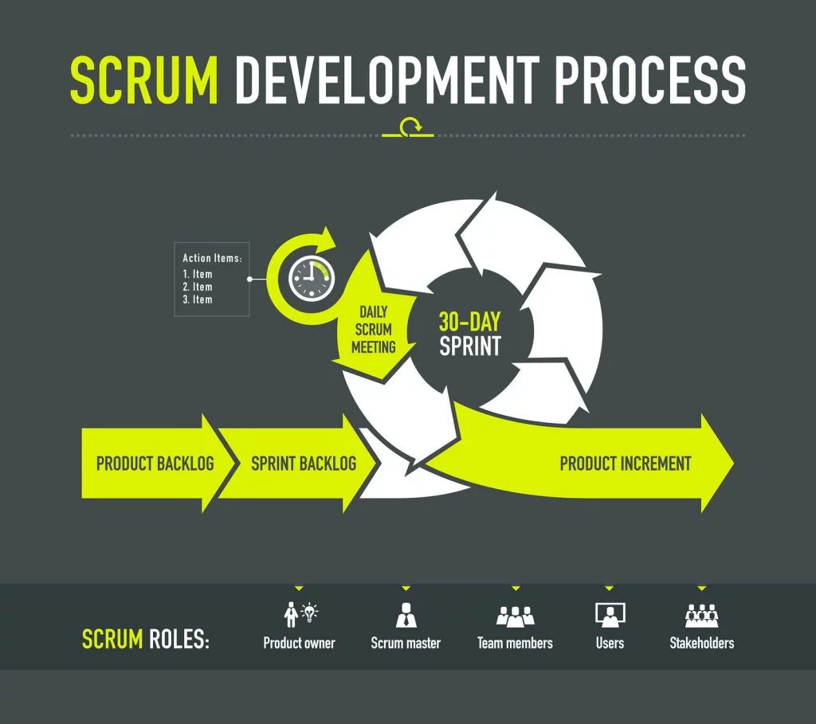

Slide 31
5.2.4 SCRUM
Different Roles in Scrum
In Scrum, the team focuses on building quality software. The owner of a Scrum project focuses on defining what are the characteristics that the product must have to build (what to build, what not and in what order) and to overcome any obstacle that could hinder the task of the development team.
The Scrum team consists of the following roles:
Product owner (PO)
Is the representative of the stakeholders and customers who use the software. They focus on the business part and is responsible for the ROI of the project. They Translate the vision of the project to the team, validate the benefits in stories to be incorporated into the Product Backlog and prioritize them on a regular basis.
2.Scrum master
The person who leads the team guiding them to comply with the rules and processes of the methodology. Scrum master manages the reduction of impediments of the project and works with the Product Owner to maximize the ROI. The Scrum Master is in charge of keeping Scrum up to date, providing coaching, mentoring and training to the teams in case it needs it.

Slide 32
5.2.4 SCRUM
Different Roles in Scrum
3. Scrum Team
A group of professionals with the necessary technical knowledge who develop the project jointly carrying out the stories they commit to at the start of each sprint.
training to the teams in case it needs it.

Slide 33
